Slide 1
Week 2 Presentation
MSA 8030 Communicating with Data – Team 5
Tyler Trocchi, Jasmine Weekes, Jared Jones
November 4, 2024

Slide 2

Business Problem
Problem: Our client, Delta Airlines, is looking to improve their operational efficiency by predicting flight departure times and analyzing delay/cancellation causes
Through some preliminary analysis, very few flights take off at their original scheduled time (early or late)
Our Solution: We aim to build a predictive model that anticipates accurate flight departure times and identifies main factors driving delays and cancellations.

Slide 3
Why is this important?
Flight delays and cancellations waste $30-$34 billion annually in the US alone (Airhelp, 2023)
Costs come from both the airline costs (fuel, crew, maintenance, etc.) and passenger costs (productivity loss, additional travel arrangements)
At least 200 million passengers were affected, with over 650 million hours lost
Detrimental to the environment-- Roughly 9 million additional tons of CO2 caused by delays/cancellations, equivalent to annual emissions of 2 million cars
Passengers are entitled to refunds in specific instances under new law signed in May 2024 (cancellations, significant delays, lost baggage and extra services)

Slide 4
Use Cases
Real-Time Departure Forecasting: A model to anticipate flight delays, enabling Delta to communicate accurate ETAs to customers and adjust resources if needed (High feasibility)
Cancellation Analysis: An investigation into cancellation patterns and causes, potentially due to weather, operational issues, or air traffic control, to reduce preventable cancellations (Moderate feasibility)
Operational Adjustments: Based on the insights, Delta can optimize flight schedules, crew assignments, and ground operations for efficiency (High feasibility)
Customer Notifications & Rebooking Assistance: Use predictive insights to notify customers of anticipated delays/cancellations early, allowing Delta to assist with alternative arrangements and maintain customer satisfaction (Moderate feasibility)

Slide 5
Additional Details and Constraints
Project Scope: Ability to start with one airline and expand to others
Constraints:
Model should be accurate and interpretable
The dataset includes historical data from 2018, which might not fully capture current patterns or the impact of recent operational changes.
Some delay causes may not be fully documented in the data and may affect the accuracy of delay predictions
Some causes of delay, such as air traffic control restrictions or adverse weather conditions, are beyond Delta’s control and may have little ability to act on them

Slide 6
Metrics of Success
The amount of money lost due to delayed and cancelled flights
Ability to identify the most significant factors in predicting flight cancellations and delays

Slide 7
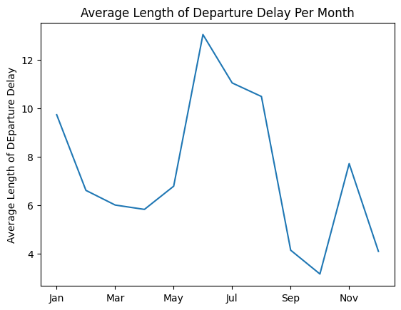
Visualization

